Slide 1
L-Band Satellite Tracking and Characterization System
Preliminary Design Review

Slide 2
Project Description
The L-Band Satellite Tracking and Characterization System is a portable ground station designed for use in radio telescope interference research.
It consists of six subsystems:
An onboard computing platform
A wireless operations software system
A motorized azimuth and elevation mount
A sensitive receiver
A high-gain antenna
A power system
Notes:
Remove second paragraph and condense to bullet points

Slide 3
Team names, roles and major, stakeholders, SME, mentor
Dr. Steve Ellingson - Subject Matter Expert/Customer - Primary Stakeholder
Dr. Shelley Stover - Mentor
Charles Kente Van Horn Jr. - Project Manager - RF and Microwave Engineering (EE)
Samuel Walker Taliaferro VIII Velasquez - Machine Learning (CPE)
Justin Daigle- Communications (EE)
Ethan Christopher Duval - Networking and Cyber Security (CPE)
Jared Lane Jamison - Controls Robotics and Autonomy (EE)

Slide 4
Meeting Schedule
Tuesday/Thursday 6:45 - Meeting with Shelly Stover(Mentor)
Tuesday 11:30-12:30 - Meeting with Steve Ellingson(Customer/SME) if needed.

Slide 5
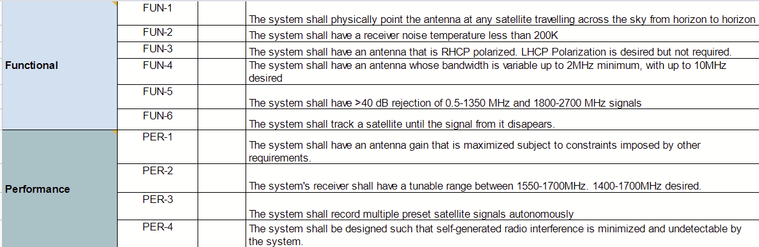
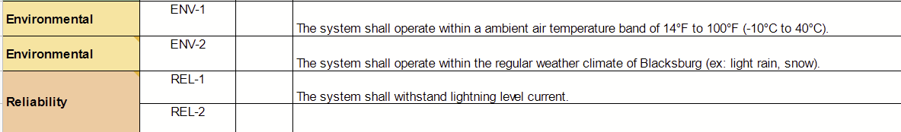
Performance Requirements and Metrics
Notes:
Use screenshot of excel spreadsheet instead

Slide 6
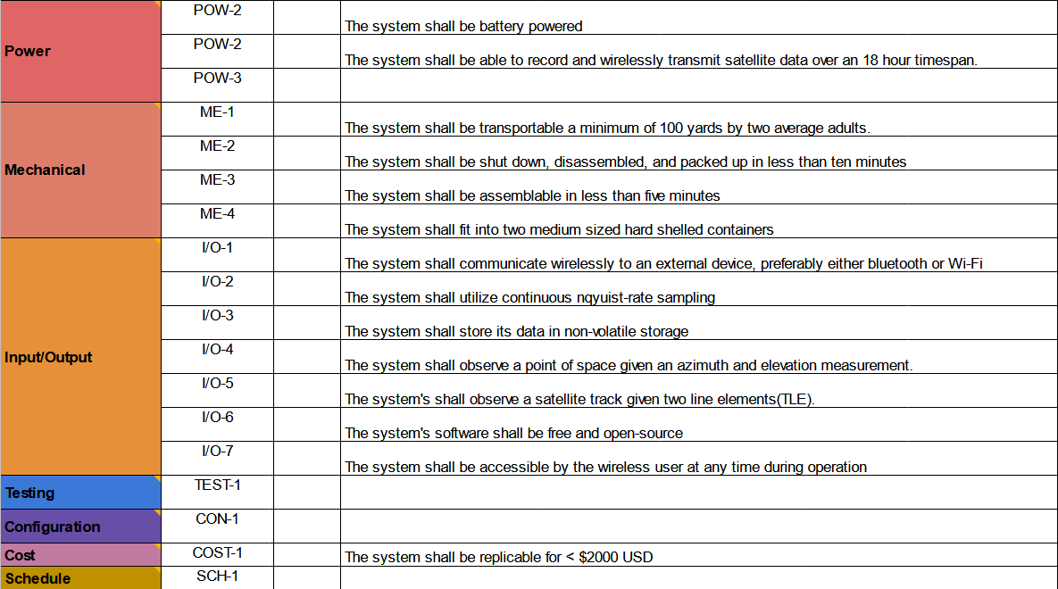
Performance Requirements and Metrics - Continued

Slide 7
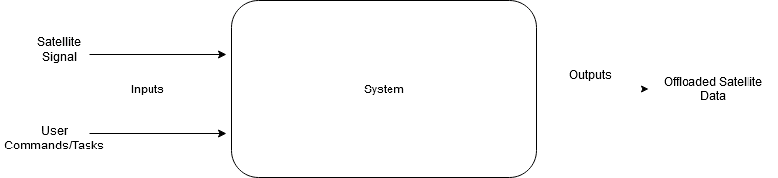
High Level System I/O Diagram
The user inputs observation tasks to the system
The system receives the observed satellite signal
The system outputs satellite spectrum data

Slide 8
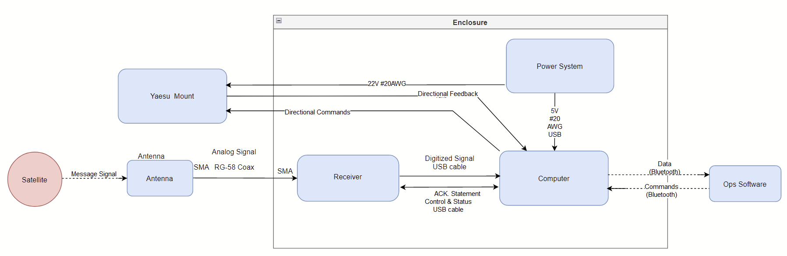
System Architecture Diagram with I/O
Blue boxes represent subsystems
Red circles represent external inputs

Slide 9
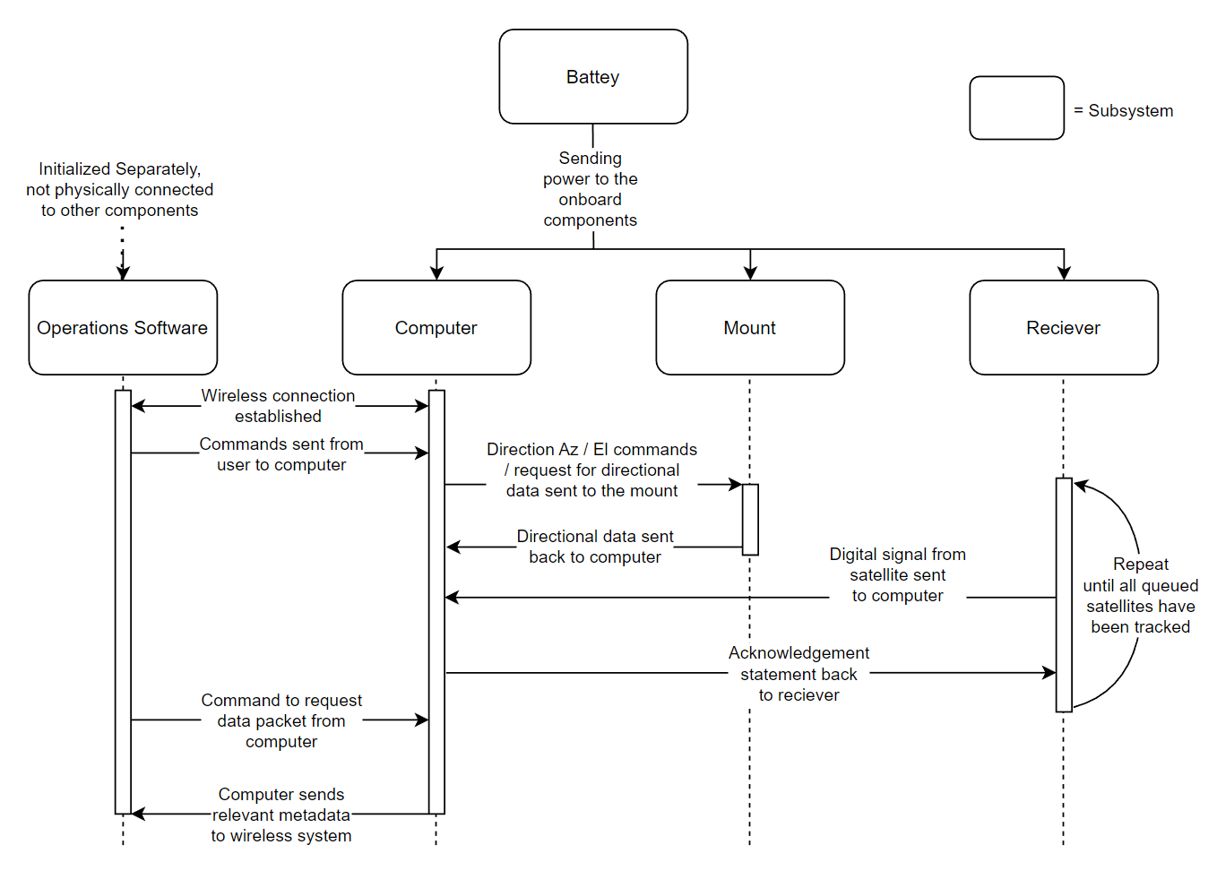
Sequence/Flow Diagram with Interfaces

Slide 10
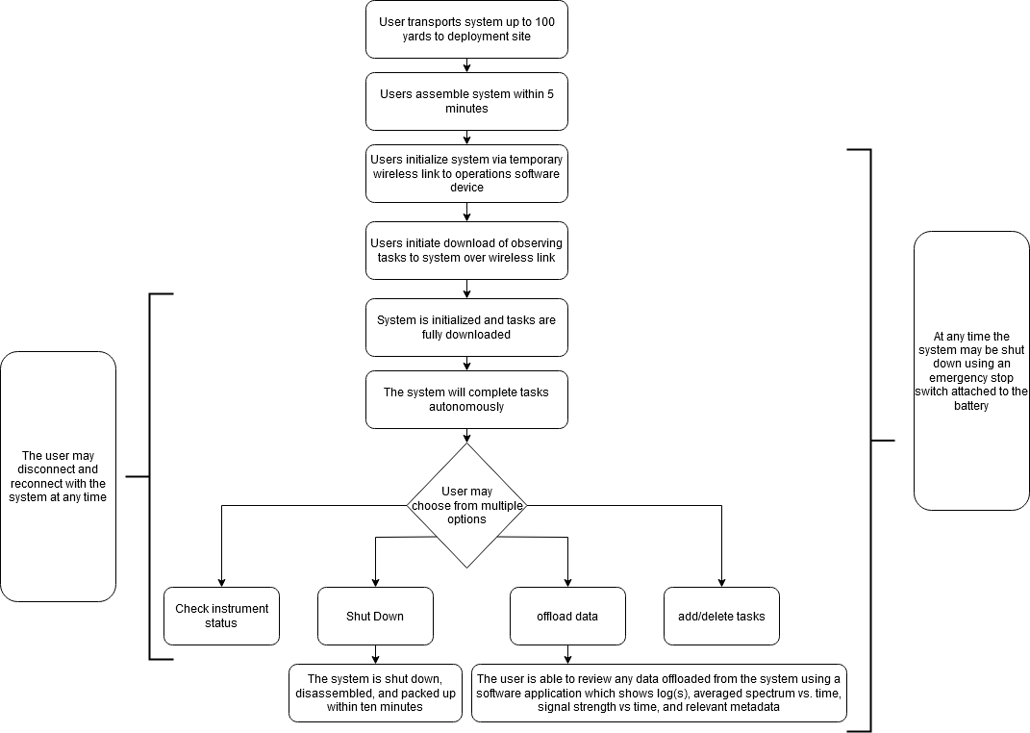
Concept of Operations

Slide 11
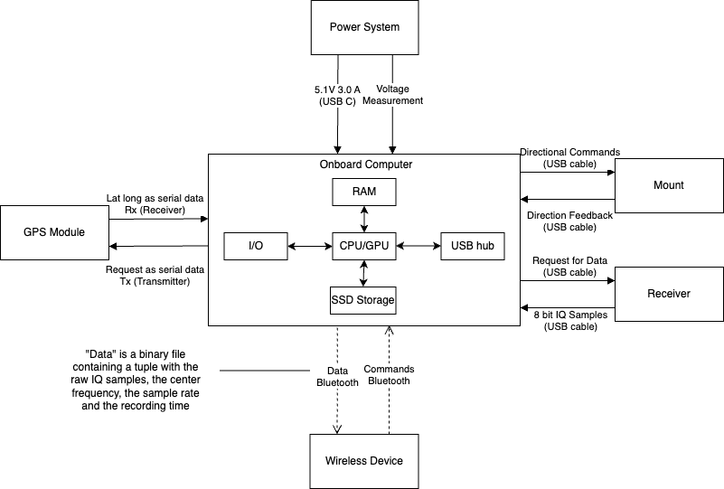
Computer Subsystem Diagram

Slide 12
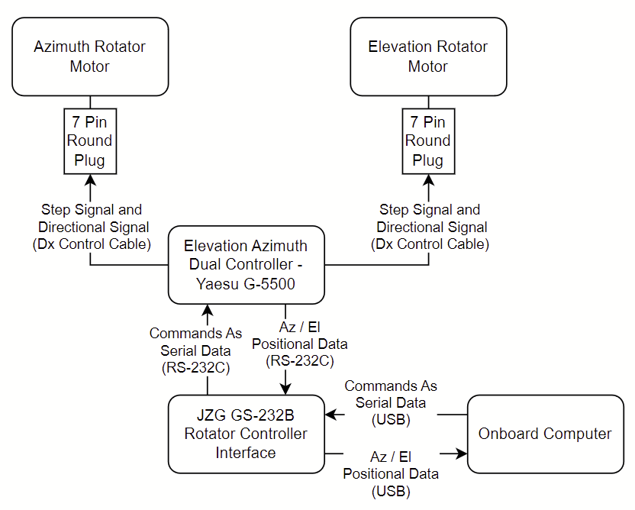
Mount Subsystem Diagram
Raspberry Pi
Notes:
Talk to ellingson about this

Slide 13
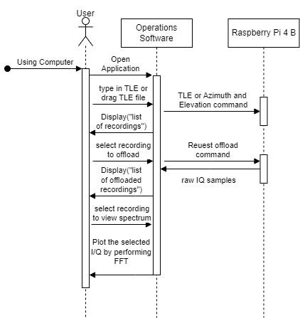
Computer Sequence Diagram
Notes:
DIscuss input more with ellingson

Slide 14
Computer: Requirements
Specific requirements: FUN-8, PER-3, PER-4, ME-1, ME-2, ME-3, I/O-2, I/O-4, COST-1
Based off of these requirements, the computer shall:
Have two USB ports, one for ADC connectivity and one for controlling the mount.
Support the ability to log system performance and diagnostics data.
Have a storage capacity of 128GB to be able to store at least 1 hour of 14-bit data sampled at 10MHz.
In addition, the computer should:
Use Bluetooth for wireless communication.
Have enough memory to record 10 minutes of I/Q sampled at 10MHz.
Have SD card port for non volatile storage.
Have a GPS connection to get its time and position in terms of longitude and latitude.
Cost less than 150$ to account for the rest of the components of the system.

Slide 15
Computer Trade Study #1: Options
 | Raspberry Pi 4 | Raspberry Pi Zero W | Arduino Mega 2560 | Arduino Uno
Total cost with requirement addons < $150 | $185 | $100 | $155 | $135
RAM > 500 MB | 1GB to 8GB | 512MB | 8KB | 2KB
CPU / Microcontroller > 10Mhz | 1.5GHz | 1GHz | 16MHz | 16MHz
General-purpose input/output | 40 | 40 | 54 | 14
Storage > 36GB | Micro SD, USB | Micro SD, Micro USB | 256KB Flash (expandable with add-ons) | 32KB Flash(expandable with add-ons)
Bluetooth Compatibility | Ethernet, Wi-Fi 4 & 5GHz, Bluetooth 5.0 | Wi-Fi 4 wireless LAN, Bluetooth 4.1, Bluetooth Low Energy (BLE) | Requires Shield Add On | Requires Shield Add On
Ports > 2 USB | 2 USB 2.0, 2 micro-HDMI | 1 micro USB, 1 mini HDMI | Requires Shield Add On | Requires Shield Add On
Power | 5.1V - 3.0A | 5.1V - 1.2A | 9V - 73.19mA | 9V - 98.43mA
GPS Required | Requires module | Requires module | Requires module | Requires module

Slide 16
Computer Trade Study #2: Comparison
Raspberry Pi 4:
Greater processing power and memory compared to Arduino.
Offers Built-in connectivity options without the need for additional shields.
Despite shortage, Raspberry Pi 4 with a GPS module can still be acquired for around $185 which is a comparable price to Arduino with required add-ons ($155).
Arduino Mega:
Has a lower power consumption than the Raspberry pi.
Requires shields for connectivity options.
Uses a variant of C++, while Raspberry pi supports Python, C and C++
Both Raspberry pi and Arduino would require a GPS module

Slide 17
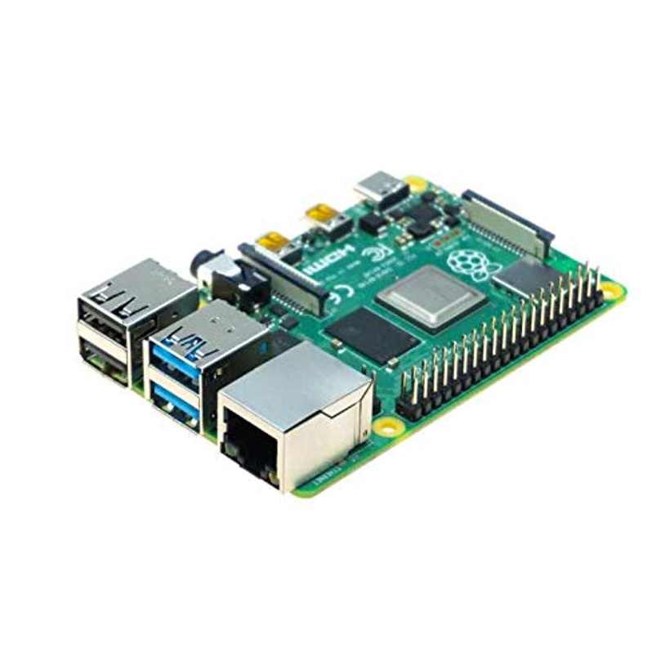
Computer Trade Study #3: Decision
Raspberry Pi 4 meets all necessary requirements with the exception of GPS which requires a module
Provides a reliable and powerful platform for the System
Raspberry Pi supports Python, a versatile and powerful programming language
Python offers extensive online resources and ease of use
Enhances the System's development and adaptability

Slide 18
Operations Software: Requirements
Specific requirements: PER-3, I/O-2, I/O-3, I/O-4, COST-1
Based off of these requirements, the software shall:
Display system status and task progress on client side
Allow user to monitor and control the system remotely
Manage data storage, offloading, and task execution autonomously
Be able to plot averaged frequency vs time, and signal strength vs time
Be able to select timed throughout the recording to view the signal at that moment
In addition, the software should:
Provide an intuitive graphical user interface for ease of operation
Communicate with the onboard computer via bluetooth.

Slide 19

Operations Software Trade Study: Buy or Build
System software consists of two main components: client side and slave computer side
Communication between components via Bluetooth
Due to unique and specific requirements, commercial software options are insufficient
Custom software development is necessary to fulfill project requirements

Slide 20
Operations Software Components and Data Processing
Develop two specific software components: client side and slave side
Both components will be programmed in Python
Communication via Bluetooth
System receives raw IQ samples as an array of imaginary and real numbers
IQ samples combined with sample rate, center frequency, and recording time
Data saved as binary files in SSD storage for later offloading

Slide 21

Client Software: GUI Features
GUI allows manual TLE input or submission via txt file
Displays lists of recordings on both slave and client devices
Enables selection of recordings on slave device for offloading or deletion
Allows selection of recordings on client side for plotting averaged spectrum vs. time and signal strength vs. time
GUI accepts fixed azimuth and elevation inputs for testing purposes

Slide 22
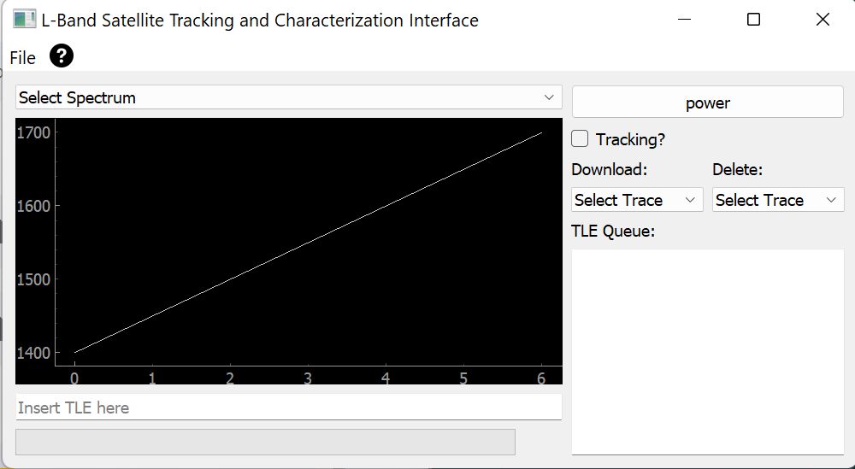
Gui Mockup

Slide 23
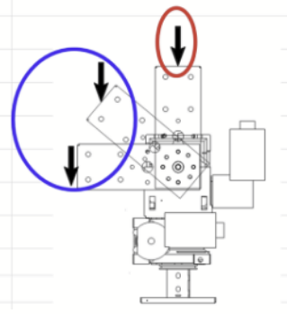
Mount System: Requirements
Specific Requirements: FUN-1, ME-1, ME-2, ME-4, ENV-1, I/O-4, COST-1
From these, the rotator must:
Include a two-dimensional rotation system.
Meet the rotational torque requirement to support our antenna at an Azimuth angle of 0° - 360° and Elevation angle of 0° - 180°.
Have the rotational speed and continuous operational time necessary to track satellites during their orbit.
Be USB capable, and able to communicate with the onboard computer over a USB connection.
In addition, the rotator should:
Remain under a total weight of 25 Kg and cost less than $1250 for the rotator and all required additional systems.
(Average carrying capacity = ~25 Kg of average male, 16 Kg for average female by HSE Standards)

Slide 24
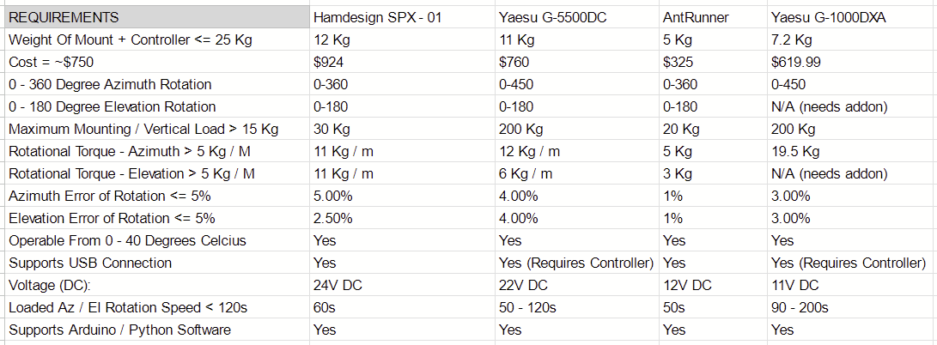
Mount System: Technical Data
Antennas/mast should not exceed 60% of the maximum rating, to ensure a safety margin - G1000DXA User Manual

Slide 25
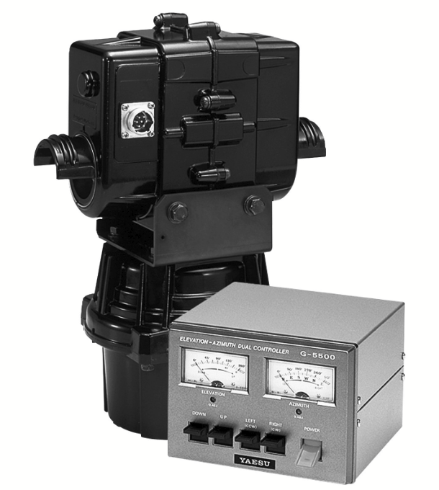
Decision: The Yaesu G-5500DC
Pros:
High vertical mounting capacity / rotational load-bearing capabilities relative to competitors.
Easy installation (Comes with build kit and required components).
Provided external controller and calibration tests.
Commonly used / trusted, online implementation tutorials and proofs of concept provided.
Yaesu motors widely supported, various coding libraries across different languages developed for Yaesu.
Cons:
Does not directly link with USB, and needs addons to achieve this functionality.
Needs additional components to be portably mounted.

Slide 26
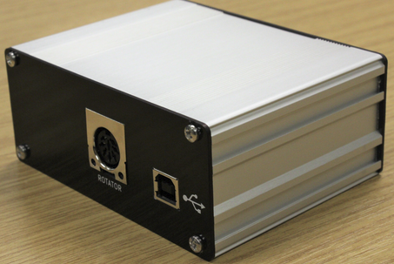
Mount Addon: JZG GS-232B
The GS-232B interface enables USB control of Yaesu antenna rotators.
Compatible with most radio software packages (PyHamTools = previously tested program), Command Reference Page provided.
Made in the UK, required shipping to the United States.
Total price of system = £95.00 or $116.85.
Total price of additional shipping = £20.00 or $24.60.

Slide 27
Receiver:
Relevant Requirements:
FUN-2: The system shall have a receiver noise temperature less than 200k
FUN-5: The system shall have a >40 dB rejection of 0.5-1350 MHz and 1800-2700 MHz signals
PER-2: The system’s receiver shall have a tunable range between 1550-1700 MHz (1400-1700 MHz desired)
I/O-6: The system’s software shall be free and open-source

Slide 28
Receiver Trade Study:
 | RTL2832U (RTL-SDR) | SDRPlay RSPDuo | Airspy R2
Frequency Range | 24 MHz - 1766 MHz | 0.001 MHz - 2000MHz | 24 MHz - 1750 MHz
ADC resolution | 8 bits | 14 bit | 12 bits
Preselectors | Tracking RF filters on the R820T2 chip | 11 built in filters +Broadcast band notch filters | Tracking RF filters on the R820T2 chip
Price | $22-33 USD | $330.77 USD | $169 USD

Slide 29
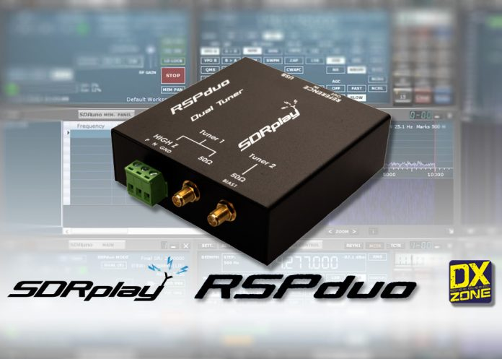
Chosen Receiver
The RSPduo is chosen as our receiver due to its:
Dual individually tunable SMA inputs
High ADC resolution,
preselection filters
Good L-Band response.

Slide 30
Antenna - System Requirements:
Relevant Requirements:
PER-1: The system shall have an antenna gain that is maximized subject to constraints imposed by other requirements.
PER-2: The system's receiver shall have a tunable range between 1550-1700 MHz. 1400-1700 MHz desired.
FUN-3: The system shall have an antenna that is RHCP polarized. LHCP Polarization is desired but not required.
COST-1: The system shall be replicable for < $2000 USD.
ME-1: The system shall be transportable a minimum of 100 yards by two average adults.
(Average carrying capacity = ~25 Kg of average male, 16 Kg for average female by HSE Standards)
ME-3: The system shall fit into two medium sized hard shelled containers.
Derived Requirements:
The antennas shall have a frequency range of 1400-1700MHz
The antennas shall be RHCP and LHCP polarized
The antennas shall be less than a meter on their longest axis
The antennas shall cost less than $300

Slide 31
Antenna Trade Study 1 - Antenna Types:
 | Crossed-Dipole Yagi | Parabolic Dish | Helical
Gain | High | Highest | High
Polarization | Circular | Circular | Circular
Bandwidth | <3% | 20-30% | ~56% of center frequency
Size | ~1m Length | ~1.5m Diameter | <1m length
Complexity | Simple | Complex | Simple
Cost Availability | Low Self-Built Only | High Low | Low Low
Size calculations based on an arbitrary desired gain of 20dBi

Slide 32
Antenna Trade Study 1: Antenna Types
Selection:
We will be using two axial mode helical antennas for our system.
One will be right hand polarized, and the other will be left hand polarized.
Other than polarization, they will be identical antennas.

Slide 33
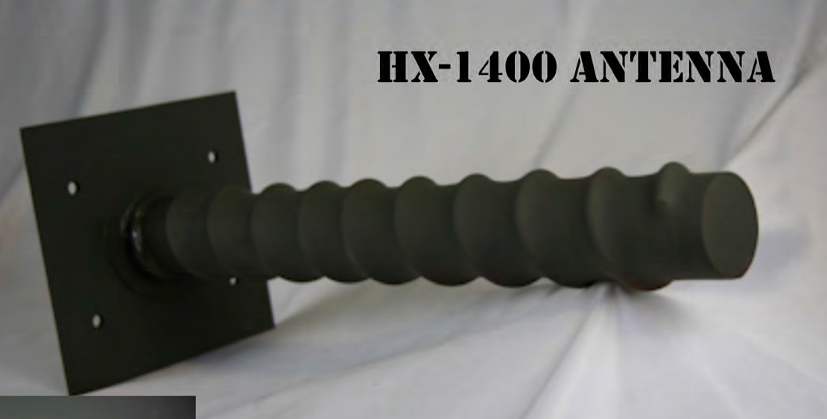
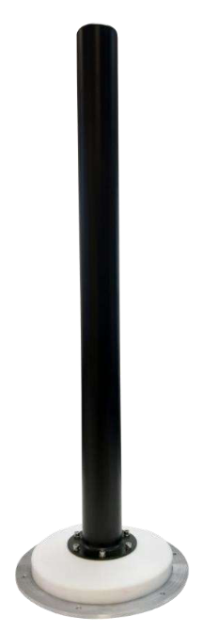
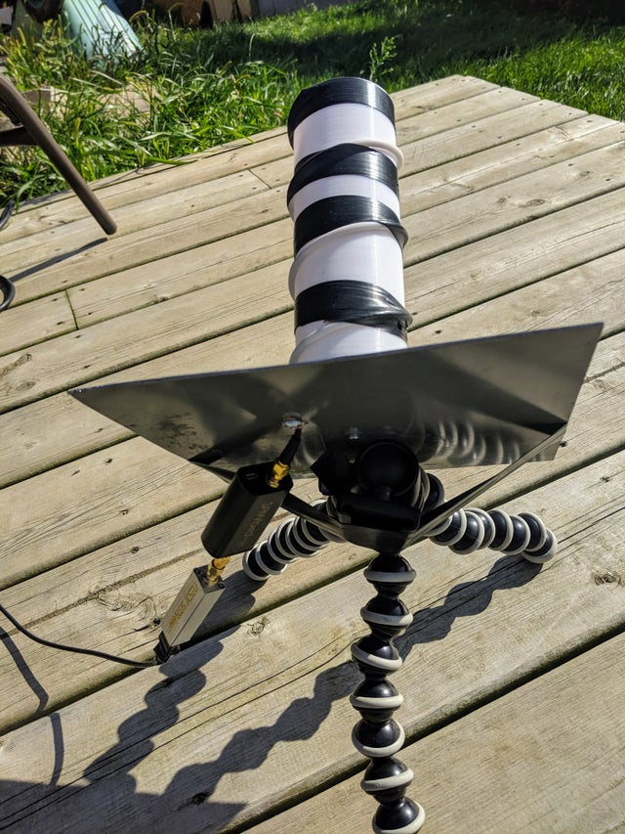
Antenna trade study 2: COTS comparison
ANTENOM HP-AMHA-11501700
PRC-COM HX-1400
SELF-BUILT

Slide 34
Antenna Trade Study 2: COTS comparison
 | HP-AMHA-11501700 | HX-1400 | SELF-BUILT
Gain (dBi) | 9.4-13.3 | 11.5 | ~9.0-15.0
Frequency Band (MHz) | 1150-1700 | 1100-1710 | 1400-1700
Cost ($) | “Too Expensive” | $1647 | <$200
Half-Power Beamwidth (degrees) | 26-49 | 30.9 | ~31
Connection Type | N-Female | SMA | SMA
Waterproof? | Yes | ? | Potentially

Slide 35
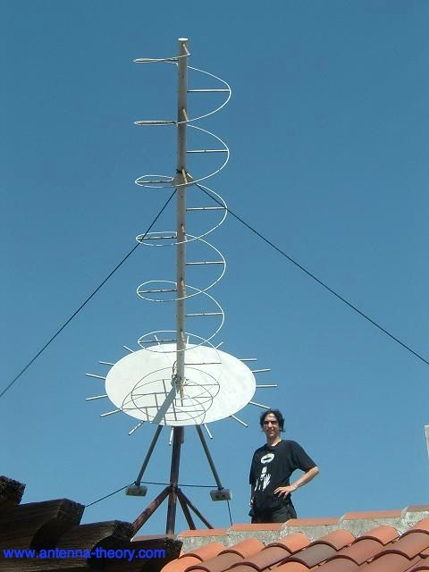
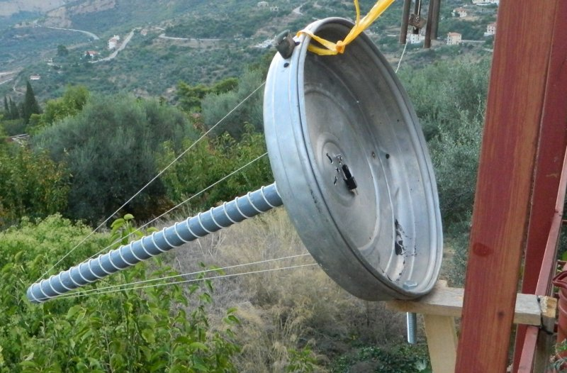
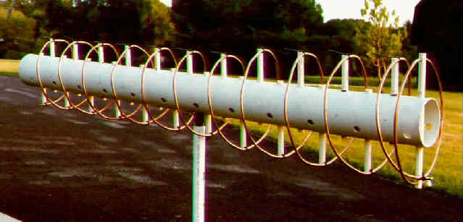
Antenna Trade Study 2: COTS Comparison
Selection:
Although all three antennas were found to be appropriate for our system, neither of the COTS options will be usable for our system.
Both the HX-1400 and the HP-AMHA-11501700 are far over budget for our system.
Therefore, the self-built option is our selection.
Helical antennas are relatively simple to design and build, and many people have successfully DIY built them before.

Slide 36
Power System Requirements
POW 1- system shall be battery powered
POW 2-System shall operate for 18 hours continuously
ME 1- System shall be potable
ME 2- System shall be transportable a minimum of 100 yards by 2 people
COST 1 - The system shall be replicable for less than $2000

Slide 37
Power System Derived Requirements
The power system shall power the mount for at least 1 hour of operation, and the computer system for 18 hours.
The Power system shall have a supply voltage of 12 volts
The supply voltage shall be stepped down using a buck converter to feed the computer system.
The supply voltage shall be stepped up using a boost converter to feed the mount system.
The battery should be a lithium ion or deep cycle battery to ensure a steady discharge rate.
The battery should also not lose charge if fully discharged.
The battery shall have an emergency stop switch tied to the power lead.
The battery should have to power the computer at max power for two hours at a minimum, and the mount for an hour and a half.

Slide 38
Power calculation
The battery must power the computer at max power for 2 hours, and at idle for the other 16. The battery must also power the mount for at least an hour and a half.
Based on this analysis, which assumes that all of the on time for the power circuit will be in a continuous line, a larger battery will be needed to avoid power drop off when not powering the circuit for possibly hours.
System | Voltage required | Amperage total | Time (hours) | Watt Hours | Amp Hours
Computer | 5V | 3A | 2 | 30Wh | 2.5Ah
Computer(low power) | 5V | 0.514A | 16 | 41.12Wh | 3.51Ah
Mount | 24V | 4.5 | 1.5 | 162Wh | 13.5
Total | N/A | N/A | N/A | 233.12Wh | 19.51

Slide 39
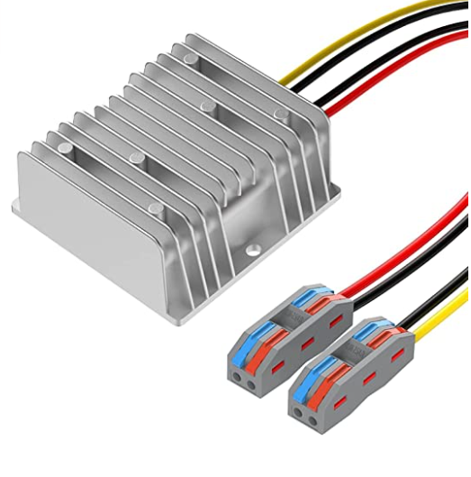
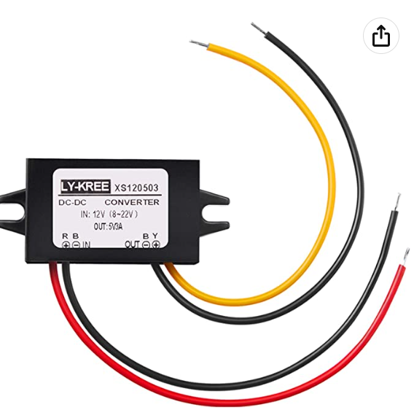
Buck and Boost Converter Circuits
Buck converters are readily sold for extremely cheap(from 12 to 5 volts, I found three for under $10), so this is not an issue.
Boost converters from 12V to 22V are not very common. We will have to make our own.
Another option is to boost the supply voltage to 120V AC, and feed the mount through the attached power cable, instead of feeding directly to the motors.
A much more attractive option is to use the motor’s voltage tolerance, and boost the battery voltage to 24V dc. This allows us to use a much more available converter.

Slide 40
Wire gauge
For the mount power line, Yaesu G5500 suggests that #20 AWG be used for applications under 100 ft. of length. Since the battery is going to be mounted either directly to the system, or within a few feet of the system #20 AWG should do fine.
For the computer power wire, the same wire can be used to simplify the parts list.
The receiver will get its power from the connection to the computer through a USB cable.

Slide 41
Additional considerations
An emergency stop will be connected to the positive terminal of the battery so that the power can be cut in an emergency.
A simple voltmeter will be connected to the battery. This is to provide the user with some sense of how much longer the battery will last. This will be connected after the emergency stop so that all electricity flow stops once the emergency stop is pressed.
Once fully discharged, the battery will take around 8 hours to charge.

Slide 42
Power Down Sequence
If the emergency stop is pressed, the only thing that will be majorly affected by a sudden loss of power is the computer, especially if it is executing instructions.
Since the Rasberry Pi 4 has many GPIO pins, one of these can be used to sense if the battery is powered on. This can be accomplished so long as the input current doesn’t exceed 16mA, and the voltage doesn’t exceed 5V. This requires a simple resistor network of 2.2Kohms and 3.3Kohms, with the output taken from the middle. This can alert the computer to a power outage, then a separate circuit can keep the Pi powered until it can be prepared for a shutdown.
Another consideration is that many charging cables for the Rasberry Pi have built in systems to alert the computer if a shutdown occurs, giving the computer the power until it can successfully power down.

Slide 43
Battery Options
Requirement | ML35-12 - 12 Volt 35 AH Lithium Battery | 12v 33ah Rechargeable Deep Cycle Battery
COST-1 | $215 | $79
ME-1/ME-2 | 10lb | 24lb
POW-1 | Maintains 12V at 1.7 amps for 20 hours | Maintains 12V 1.7 amps for 20 hours
Derived Req. 1 | 12V | 12V
Derived Req. 6 | Lasts for around 3000 cycles if fully discharged. | Lasts around 200-300 cycles if fully discharged

Slide 44
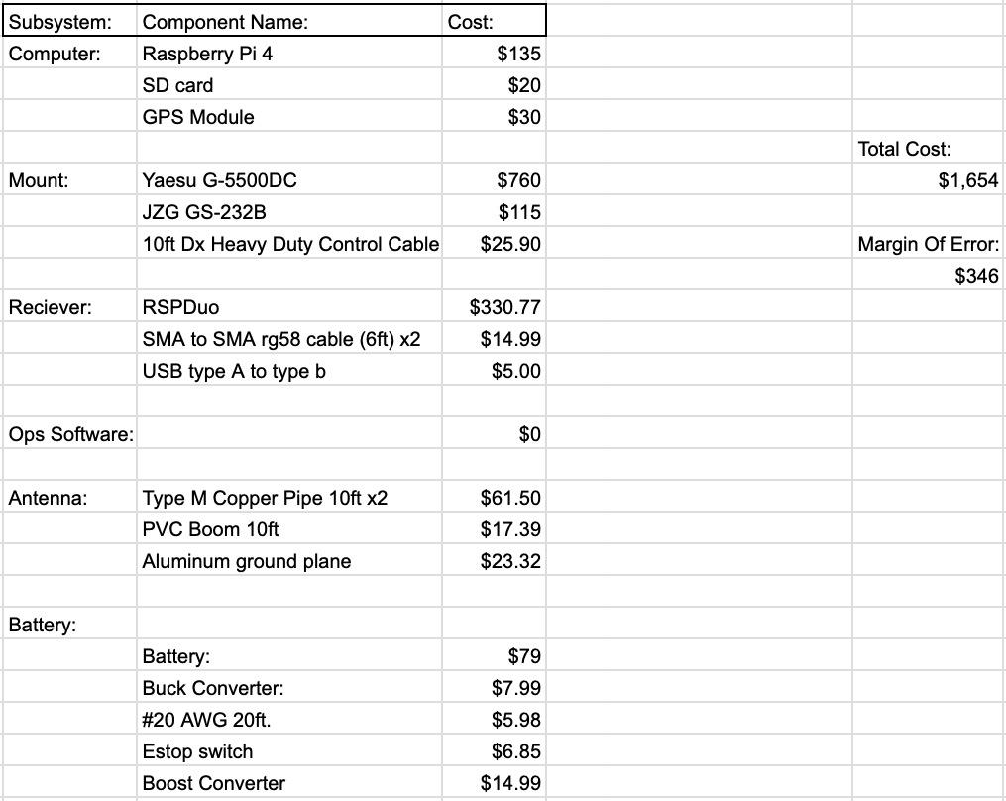
Project Management: Costs

Slide 45
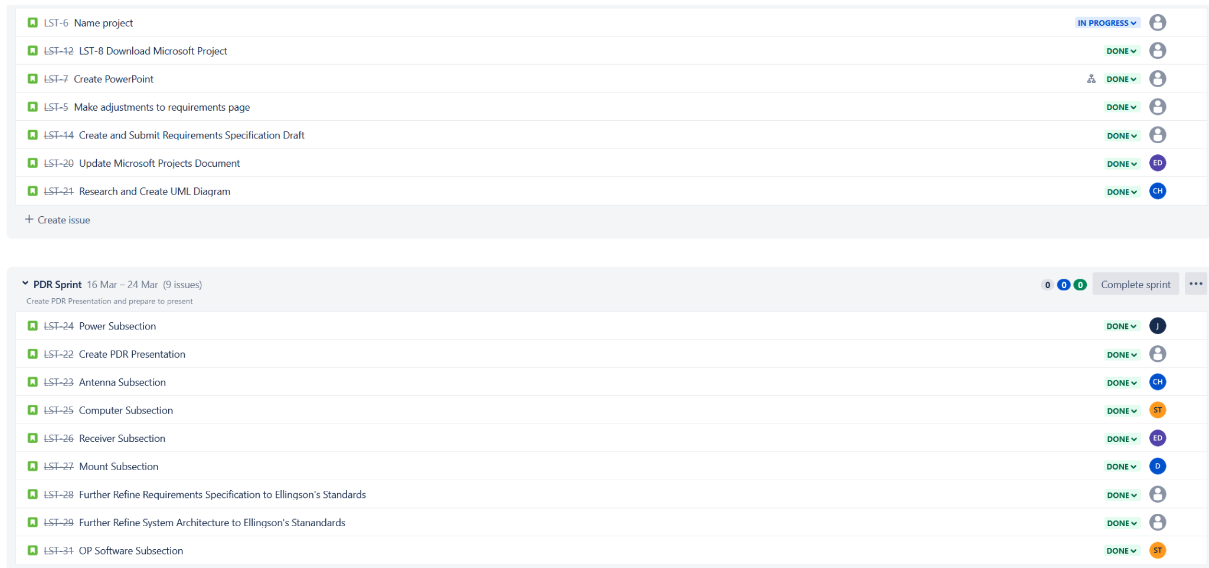
Project Management: Approach
Jira Taskboard:

Slide 46
Risks
Likelyhood Scale: 1 = Lowest, 5 = Highest
Risk: | Score: | Associated Consequence
The price of the Raspberry Pi can vary due to chip shortage | 1 | We will be constrained to those available through the course.
Long part lead times, particularly for filters | 4 | Assembly and testing will be delayed.
Antenna iteration process may be more time consuming than anticipated | 2 | System assembly and testing will be delayed, target specifications may not be met.
The software might take longer to develop than anticipated | 5 | The testing and functionality of the system would be halted until the software is complete.
The budget for our project design may be adjusted or not approved | 3 | New system components would have to be chosen and the whole system redesigned.

Slide 47
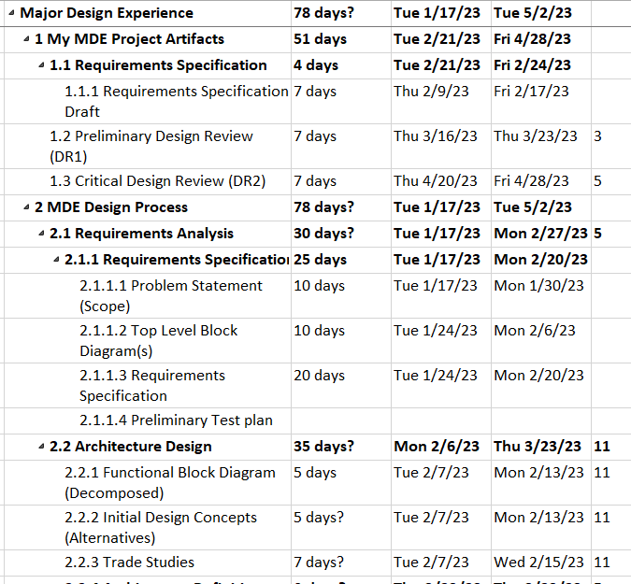
Formal Schedule

Slide 48
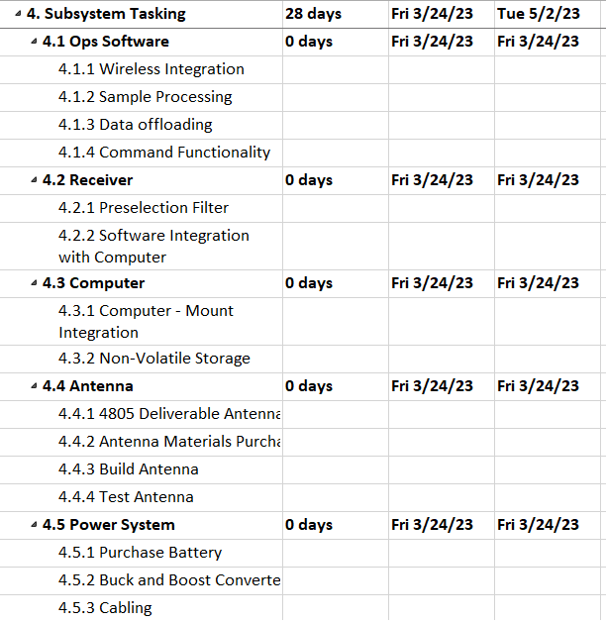
Formal Schedule cont.

Slide 49
Blank Actions Table
Action # | Requirement | Existing documentation | Plan to fix | Fixed
Confirm that the values for the numbers are met by the engineering standards | ME-1 | The existing documentation does not conform to engineering weight standards. | Find the engineering standards on how much weight is safe for an average adult to transport. | Yes
Figure out the time data requirements for the Ops Software (GPS MODULE) |  |  |  | Yes
Talk to Ellingson about slide 12 | N/A |  | Email Ellingson, and possibly talk to him. | Yes

Slide 50
Blank Actions Cot.
Action # | Requirement | Problem | Plan to fix | Fixed
Talk to Dr. Ellingson about the GUI on slide 13 | PER-3 |  | Email Dr. Ellingson, and possibly see him in person. | Yes
Add A QT Mock |  |  | Add a mock QT to the slides | Yes
Add power chart to power slides, that says the amount of power used for each mode. | POW-1 POW-2 | The calculation that exists is not readable, and is a formula. | Eliminate the formula so that he power for each system is in a table, and more easily read. | Yes
Resolve the data sampling issue | I/O-1 I/O-2 | The storage capacity, should not be a range, it should be a consistent number. | Figure out the storage and then implement this information. | Yes

Slide 51
Blank Actions Cotd.
Action # | Requirement | Problem | Plan to fix | Fixed
Operations software derived requirements (spectrum, FFT) need to be fixed. | OP Software derived requirement |  | Figure out the correct radio spectrum, and if we are going to implement an FFT and put these requirements in. | Yes
Risks (give top 5) should have likelihood and consequence | N/A | There are no risks involved, and the few we had did not have a consequence or a probability attached. | Figure out what our risks are, how they could affect our project, and how to mitigate them. | Yes
Make a power down sequence, so that the system is ready for an emergency stop. | N/A | The Emergency switch to be added could damage the computer if not properly implemented. | Figure out a way to prepare the computer for a forced shut down so that it is not destroyed. | Yes

